Slide 1
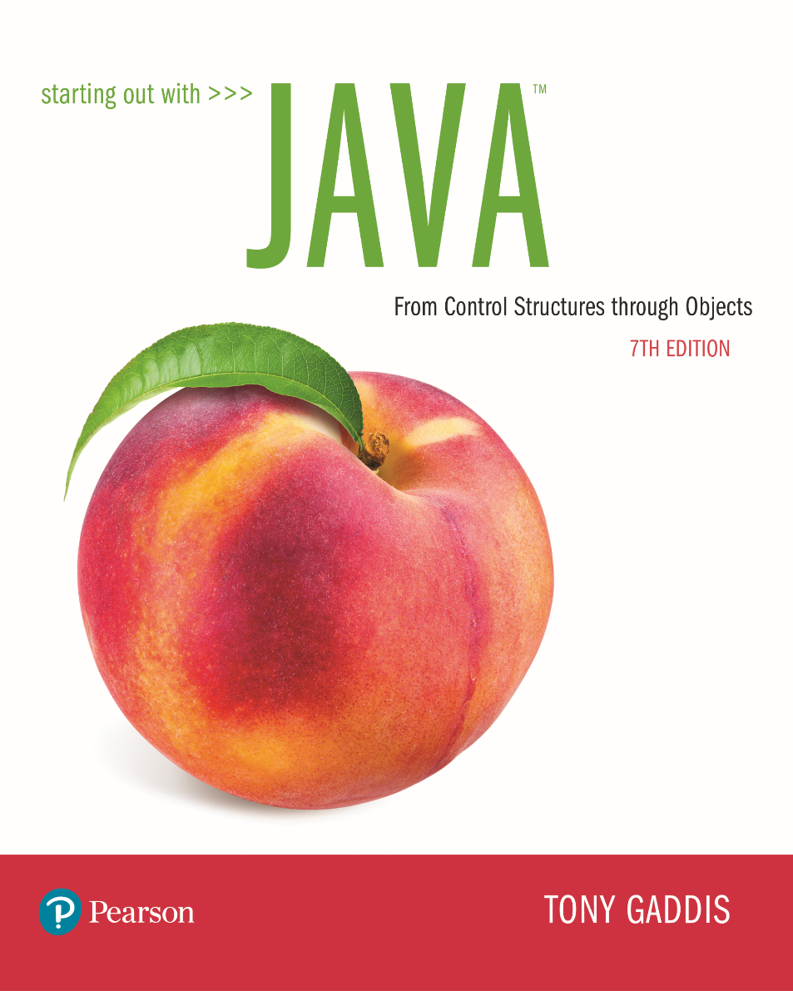

Slide 2
Examples’ Source Code
Source Code for examples presented in these slides can be found on:
Blackboard->Course Content->Source Code Of The Book Examples

Slide 3
Module 7 Topics
6.1 Objects and Classes
6.2 Writing a Simple Class, Step by Step
6.3 Instance Fields and Methods
6.4 Constructors
6.5 Passing Objects as Arguments
6.6 Overloading Methods and Constructors
6.7 Scope of Instance Fields
6.8 Packages and import Statements
6.9 Focus on Object-Oriented Design: Finding the Classes
and Their Responsibilities
8.4 The toString Method
UML - class Diagrams, dependency
Cohesion
Coupling
Memory Mapping

Slide 4
Objects and Classes
An object exists in memory, and performs a specific task.
Objects have two general capabilities:
Objects can store data. The pieces of data stored in an object are also known as fields/attributes.
Objects can perform operations. The operations that an object can perform are known as methods.

Slide 5
Objects and Classes
You have already used the following object:
Scanner objects, for reading input
When a program needs the services of a particular type of object, it creates that object in memory, and then calls that object's methods as necessary.

Slide 6
Objects and Classes
Classes: Where Objects Come From
A class is code that describes a particular type of object. It specifies the data that an object can hold (the object's fields), and the actions that an object can perform (the object's methods).
You can think of a class as a code "blueprint" that can be used to create a particular type of object.

Slide 7
Objects and Classes
When a program is running, it can use the class to create, in memory, as many objects of a specific type as needed.
Each object that is created from a class is called an instance of the class.

Slide 8
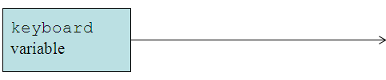
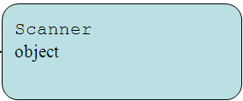
Objects and Classes
This expression creates a Scanner object in memory.
Example:
Scanner keyboard = new Scanner(System.in);
The object's memory address is assigned to the keyboard variable.

Slide 9
Objects and Classes
This expression creates a Random object in memory.
Example:
Random rand = new Random();
The object's memory address is assigned to the rand variable.
Random
object
rand
variable

Slide 10
Objects and Classes
This expression creates a PrintWriter object in memory.
Example:
PrintWriter outputFile = new PrintWriter("numbers.txt");
The object's memory address is assigned to the outputFile variable.
PrintWriter
object
outputFile
variable

Slide 11
Objects and Classes
The Java API provides many classes
So far, the classes that you have created objects from are provided by the Java API.
Examples:
Scanner
Random
User can define their own classes
Figure out what data it needed
Determine the methods

Slide 12
Writing a Class, Step by Step
What type of methods would we want to provide?
A Rectangle object will have the following fields:
length. The length field will hold the rectangle’s length.
width. The width field will hold the rectangle’s width.

Slide 13
Writing a Class, Step by Step
The Rectangle class will also have the following methods:
setLength. The setLength method will store a value in an object’s length field.
setWidth. The setWidth method will store a value in an object’s width field.
getLength. The getLength method will return the value in an object’s length field.
getWidth. The getWidth method will return the value in an object’s width field.
getArea. The getArea method will return the area of the rectangle, which is the result of the object’s length multiplied by its width.

Slide 14
UML Diagram
Class name goes here
Fields are listed here
Methods are listed here
Unified Modeling Language (UML) provides a set of standard diagrams for graphically depicting object-oriented systems.

Slide 15
UML Diagram for Rectangle class
Rectangle
length
width
setLength() setWidth() getLength() getWidth() getArea()

Slide 16
Writing the Code for the Class Fields
public class Rectangle
{
// data or instance variables
private double length;
private double width;
}

Slide 17
Access Specifiers
An access specifier is a Java keyword that indicates how a field or method can be accessed.
public
When the public access specifier is applied to a class member, the member can be accessed by code inside the class or outside.
private
When the private access specifier is applied to a class member, the member cannot be accessed by code outside the class. The member can be accessed only by methods that are members of the same class.

Slide 18
Header for the setLength Method
Notice the word static does not appear in the method header designed to work on an instance of a class (instance method).
Return Type
Access specifier
Method Name
public void setLength (double len)
Parameter variable declaration

Slide 19
Writing and Demonstrating the setLength Method
/**
The setLength method stores a value in the
length field.
@param len The value to store in length.
*/
public void setLength(double len)
{
length = len;
}
Examples: Rectangle.java, LengthDemo.java

Slide 20
/**
Rectangle class, phase 1
Under construction!
*/
public class Rectangle
{
private double length;
private double width;
/**
The setLength method stores a value in the
length field.
@param len The value to store in length.
*/
public void setLength(double len)
{
length = len;
}
}

Slide 21
/**
This program demonstrates the Rectangle class's setLength method.
*/
public class LengthDemo
{
public static void main(String[] args)
{
// Create a Rectangle object and assign its address to the box variable.
Rectangle box = new Rectangle();
// Indicate what we are doing.
System.out.println("Sending the value 10.0 " + "to the setLength method.");
// Call the box object's setLength method.
box.setLength(10.0);
// Indicate we are done.
System.out.println("Done.");
}
}

Slide 22
Creating a Rectangle object
Rectangle box = new Rectangle ();
A Rectangle object
The box variable holds the address of the Rectangle object.
length:
0.0
address
width:
0.0

Slide 23
Calling the setLength Method
box.setLength(10.0);
A Rectangle object
The box variable holds the address of the Rectangle object.
length:
10.0
address
width:
0.0
This is the state of the box object after the setLength method executes.

Slide 24
Writing the getLength Method
/**
The getLength method returns a Rectangle
object's length.
@return The value in the length field.
*/
public double getLength()
{
return length;
}
Similarly, the setWidth and getWidth methods can be created.
Examples: Rectangle.java, LengthWidthDemo.java

Slide 25
Writing and Demonstrating the getArea Method
/**
The getArea method returns a Rectangle
object's area.
@return The product of length times width.
*/
public double getArea()
{
return length * width;
}
Examples: Rectangle.java, RectangleDemo.java

Slide 26
Accessor and Mutator Methods
Because of the concept of data hiding, fields in a class are private.
The methods that retrieve the data of fields are called accessors.
The methods that modify the data of fields are called mutators.
Each field that the programmer wishes to be viewed by other classes needs an accessor.
Each field that the programmer wishes to be modified by other classes needs a mutator.

Slide 27
Accessors and Mutators
For the Rectangle example, the accessors and mutators are:
setLength : Sets the value of the length field.
public void setLength(double len) …
setWidth : Sets the value of the width field.
public void setLength(double w) …
getLength : Returns the value of the length field.
public double getLength() …
getWidth : Returns the value of the width field.
public double getWidth() …
Other names for these methods are getters and setters.

Slide 28
UML Diagram for Rectangle class
Rectangle
Accessors:
getWidth
getLength
Mutators:
setLength
setWidth
length width
setLength() setWidth() getLength() getWidth() getArea()
Which methods are accessors, mutators?

Slide 29
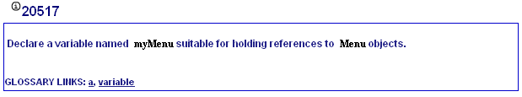
My Programming Lab 2 – 6.1

Slide 30
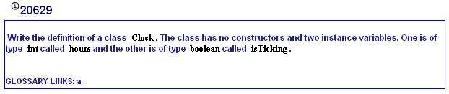
My Programming Lab 2 – 6.2

Slide 31
Data Hiding
An object hides its internal, private fields from code that is outside the class that the object is an instance of.
Only the class's methods may directly access and make changes to the object’s internal data.
Code outside the class must use the class's public methods to operate on an object's private fields.

Slide 32
Data Hiding
Data hiding is important because classes are typically used as components in large software systems, involving a team of programmers.
Data hiding helps enforce the integrity of an object's internal data.

Slide 33
Stale Data
Some data is the result of a calculation.
Consider the area of a rectangle.
length × width
It would be impractical to use an area variable here.
Data that requires the calculation of various factors has the potential to become stale.
To avoid stale data, it is best to calculate the value of that data within a method rather than store it in a variable.

Slide 34
Stale Data
Rather than use an area variable in a Rectangle class:
public double getArea()
{
return length * width;
}
This dynamically calculates the value of the rectangle’s area when the method is called.
Now, any change to the length or width variables will not leave the area of the rectangle stale.

Slide 35
UML Data Type and Parameter Notation
UML diagrams are language independent.
UML diagrams use an independent notation to show return types, access modifiers, etc.
Access modifiers are denoted as:
- private
+ public
Rectangle
- width : double
+ setWidth(w : double) : void

Slide 36
UML Data Type and Parameter Notation
UML diagrams are language independent.
UML diagrams use an independent notation to show return types, access modifiers, etc.
Variable types are placed after the variable name, separated by a colon.
Rectangle
- width : double
+ setWidth(w : double) : void

Slide 37
UML Data Type and Parameter Notation
UML diagrams are language independent.
UML diagrams use an independent notation to show return types, access modifiers, etc.
Rectangle
Method return types are placed after the method declaration name, separated by a colon.
- width : double
+ setWidth(w : double) : void

Slide 38
UML Data Type and Parameter Notation
UML diagrams are language independent.
UML diagrams use an independent notation to show return types, access modifiers, etc.
Method parameters are shown inside the parentheses using the same notation as variables.
Rectangle
- width : double
+ setWidth(w : double) : void

Slide 39
Converting the UML Diagram to Code
Putting all of this information together, a Java class file can be built easily using the UML diagram.
The UML diagram parts match the Java class file structure.
class header
{
Fields
Methods
}
ClassName
Fields
Methods

Slide 40
Converting the UML Diagram to Code
The structure of the class can be compiled and tested without having bodies for the methods. Just be sure to put in dummy return values for methods that have a return type other than void.
public class Rectangle
{
private double width;
private double length;
public void setWidth(double w)
{
}
public void setLength(double len)
{
}
public double getWidth()
{ return 0.0;
}
public double getLength()
{ return 0.0;
}
public double getArea()
{ return 0.0;
}
}
Rectangle
width : double
length : double
+ setWidth(w : double) : void
+ setLength(len : double): void
+ getWidth() : double
+ getLength() : double
+ getArea() : double

Slide 41
Converting the UML Diagram to Code
public class Rectangle
{
private double width;
private double length;
public void setWidth(double w)
{ width = w;
}
public void setLength(double len)
{ length = len;
}
public double getWidth()
{ return width;
}
public double getLength()
{ return length;
}
public double getArea()
{ return length * width;
}
}
Once the class structure has been tested, the method bodies can be written and tested.
Rectangle
width : double
length : double
+ setWidth(w : double) : void
+ setLength(len : double): void
+ getWidth() : double
+ getLength() : double
+ getArea() : double

Slide 42
Class Layout Conventions
The layout of a source code file can vary by employer or instructor.
A common layout is:
Fields listed first
Methods listed second
Accessors and mutators are typically grouped.
There are tools that can help in formatting layout to specific standards.

Slide 43
Instance Fields and Methods
Fields and methods that are declared as previously shown are called instance fields and instance methods.
Objects created from a class each have their own copy of instance fields.
Instance methods are methods that are not declared with a special keyword, static.

Slide 44
States of Three Different Rectangle Objects
The kitchen variable holds the address of a Rectangle Object.
length:
10.0
address
width:
14.0
The bedroom variable holds the address of a Rectangle Object.
length:
15.0
address
width:
12.0
The den variable holds the address of a Rectangle Object.
length:
20.0
address
width:
30.0

Slide 45
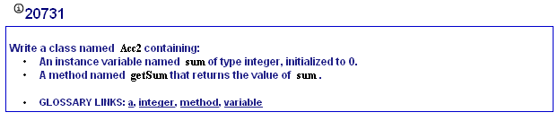
My Programming Lab 2 – 6.3

Slide 46
Constructors
Classes can have special methods called constructors.
A constructor is a method that is automatically called when an object is created.
Constructors are used to perform operations at the time an object is created.
Constructors typically initialize instance fields and perform other object initialization tasks.

Slide 47
Constructors
Constructors have a few special properties that set them apart from normal methods.
Constructors have the same name as the class.
Constructors have no return type (not even void).
Constructors may not return any values.
Constructors are typically public.

Slide 48
Constructor for Rectangle Class
/**
Constructor
@param len The length of the rectangle.
@param w The width of the rectangle.
*/
public Rectangle(double len, double w)
{
length = len;
width = w;
}
Examples: Rectangle.java, ConstructorDemo.java

Slide 49
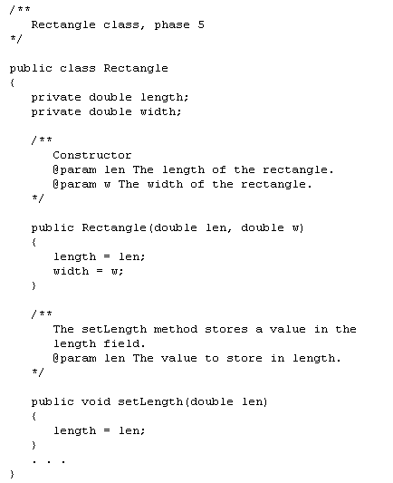
Is this a
Data element or
driver class?
Data element

Slide 50
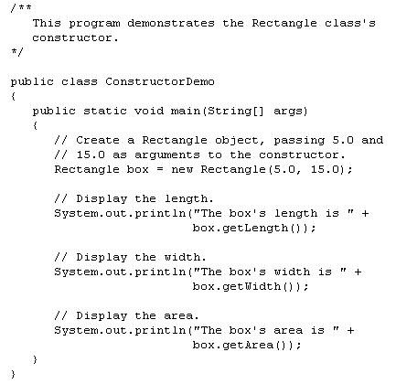
Driver class
An object is
created
length:
5.0
address
width:
15.0
The address of
the new object
is returned and
assigned to box

Slide 51
Constructors in UML
In UML, the most common way constructors are defined is:
Rectangle
Notice there is no
return type listed
for constructors.
width : double
length : double
+Rectangle(len:double, w:double)
+ setWidth(w : double) : void
+ setLength(len : double): void
+ getWidth() : double
+ getLength() : double
+ getArea() : double

Slide 52
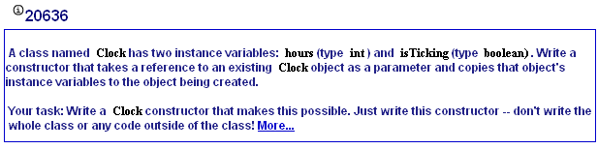
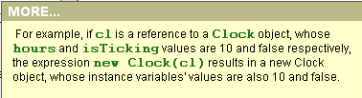
MyProgrammingLab3 6.4
**This is referred to as a copy constructor

Slide 53
Uninitialized Local Reference Variables
What will happen when this code is run?
Rectangle box;
box.setLength(10.0);
NullPointerException
Reference variables can be declared without being initialized.
Rectangle box;
This statement does not create a Rectangle object, so it is an uninitialized local reference variable.
A local reference variable must reference an object before it can be used, otherwise a compiler error will occur.
box = new Rectangle(7.0, 14.0);
box will now reference a Rectangle object of length 7.0 and width 14.0.

Slide 54
The Default Constructor
When an object is created, its constructor is always called.
If you do not write a constructor, Java provides one when the class is compiled. The constructor that Java provides is known as the default constructor.
It sets all of the object’s numeric fields to 0.
It sets all of the object’s boolean fields to false.
It sets all of the object’s reference variables to the special value null.

Slide 55
The Default Constructor
The default constructor is a constructor with no parameters, used to initialize an object in a default configuration.
The only time that Java provides a default constructor is when you do not write any constructor for a class.
A default constructor is not provided by Java if a constructor is already written.

Slide 56
Writing Your Own No-Arg Constructor
A constructor that does not accept arguments is known as a no-arg constructor.
The default constructor (provided by Java) is a no-arg constructor.
We can write our own no-arg constructor
public Rectangle()
{
length = 1.0;
width = 1.0;
}

Slide 57
The String Class Constructor
One of the String class constructors accepts a string literal as an argument.
This string literal is used to initialize a String object.
For instance:
String name = new String("Michael Long");

Slide 58
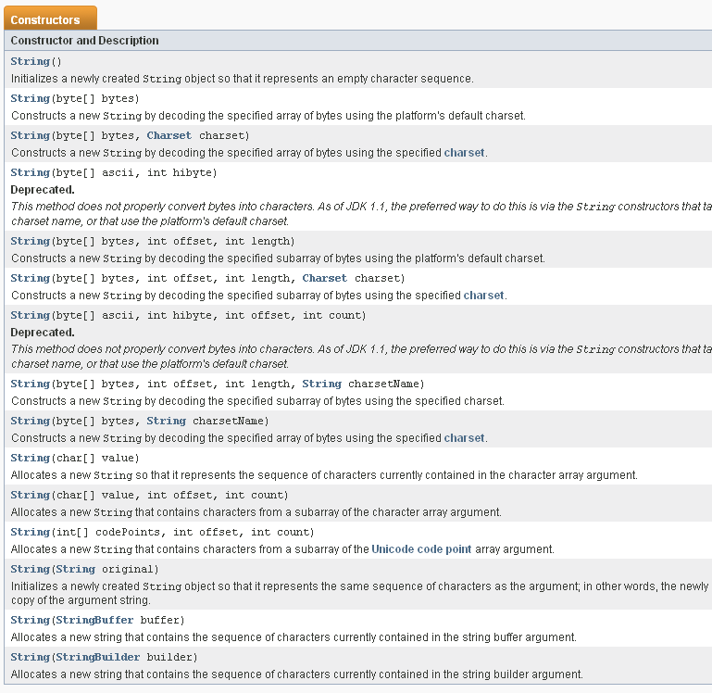

Slide 59
The String Class Constructor
This creates a new reference variable name that references a String object that represents the name “Michael Long”
Because they are used so often, String objects can be created with a shorthand:
String name = "Michael Long";

Slide 60
Passing Objects as Arguments
When you pass a object as an argument, the thing that is passed into the parameter variable is the object's memory address.
As a result, parameter variable references the object, and the receiving method has access to the object.
See DieArgument.java

Slide 61
Overloading Methods and Constructors
Two or more methods in a class may have the same name as long as their parameter lists are different.
When this occurs, it is called method overloading. This also applies to constructors.
Method overloading is important because sometimes you need several different ways to perform the same operation.

Slide 62
Overloaded Method add
same name
different parameters
public int add(int num1, int num2)
{
int sum = num1 + num2;
return sum;
}
public String add (String str1, String str2)
{
String combined = str1 + str2;
return combined;
}

Slide 63
Method Signature and Binding
Signatures of the add methods of previous slide
A method signature consists of the method’s name and the data types of the method’s parameters, in the order that they appear. The return type is not part of the signature.
add(int, int)
add(String, String)
The process of matching a method call with the correct method is known as binding. The compiler uses the method signature to determine which version of the overloaded method to bind the call to.

Slide 64
Rectangle Class Constructor Overload
If we were to add the no-arg constructor we wrote previously to our Rectangle class in addition to the original constructor we wrote, what would happen when we execute the following calls?
Rectangle box1 = new Rectangle();
Rectangle box2 = new Rectangle(5.0, 10.0);

Slide 65
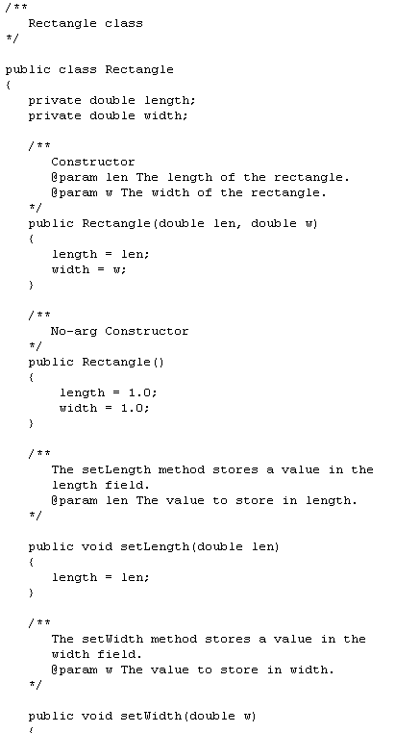
what would the values of length and width be if we execute the following calls within the client code?
Rectangle box1 = new Rectangle();
Rectangle box2 = new
Rectangle(5.0, 10.0);
The first call would use the no-arg constructor and box1 would have a length of 1.0 and width of 1.0.
The second call would use the original constructor and box2 would have a length of 5.0 and a width of 10.0.

Slide 66
The BankAccount Example
BankAccount
-balance:double
+BankAccount()
+BankAccount(startBalance:double)
+BankAccount(str:String)
+deposit(amount:double):void
+deposit(str:String):void
+withdraw(amount:double):void
+withdraw(str:String):void
+setBalance(b:double):void
+setBalance(str:String):void
+getBalance():double
Overloaded Constructors
Overloaded deposit methods
Overloaded withdraw methods
Overloaded setBalance methods

Slide 67
Scope of Instance Fields
How do I know if a method is an instance method?
It doesn’t have
“static” in the header
Variables declared as instance fields in a class can be accessed by any instance method in the same class as the field.
If an instance field is declared with the public access specifier, it can also be accessed by code outside the class, as long as an instance of the class exists.

Slide 68
Shadowing
A parameter variable is, in effect, a local variable.
Within a method, variable names must be unique.
A method may have a local variable with the same name as an instance field.
This is called shadowing.
The local variable will hide the value of the instance field.
Shadowing is discouraged and local variable names should not be the same as instance field names.

Slide 69
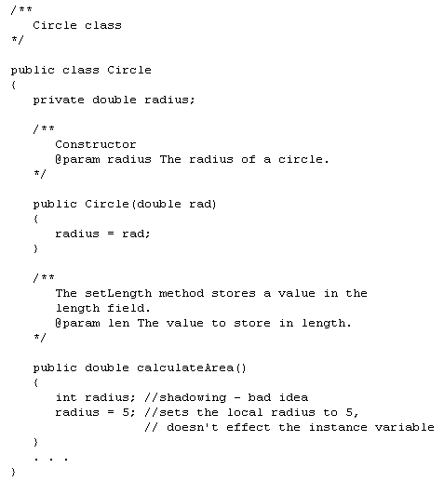

Slide 70
Packages and import Statements
Classes in the Java API are organized into packages.
Explicit and Wildcard import statements
Explicit imports name a specific class
import java.util.Scanner;
Wildcard imports name a package, followed by an *
import java.util.*;
The java.lang package is automatically made available to any Java class.

Slide 71
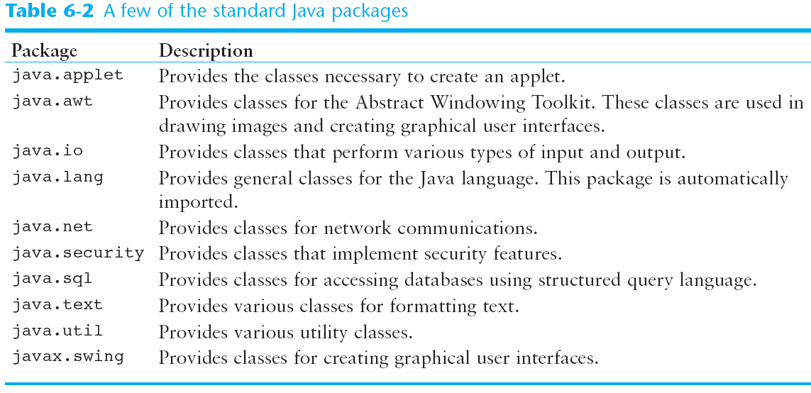
Some Java Standard Packages

Slide 72
Object Oriented Design Finding Classes and Their Responsibilities
Finding the classes
Get written description of the problem domain
Identify all nouns, each is a potential class
Refine list to include only classes relevant to the problem
Identify the responsibilities
Things a class is responsible for knowing
Things a class is responsible for doing
Refine list to include only classes relevant to the problem

Slide 73
Object Oriented Design Finding Classes and Their Responsibilities
Identify the responsibilities
Things a class is responsible for knowing
Things a class is responsible for doing
Refine list to include only classes relevant to the problem

Slide 74
Object Oriented Design Finding Classes and Their Responsibilities
A class represents a single concept from the problem domain
Name for a class should be a noun that describes concept
Concepts from mathematics:
Point
Rectangle
Ellipse
Concepts from real life:
BankAccount CashRegister

Slide 75
Object Oriented Design Finding Classes and Their Responsibilities
Actors (end in -er, -or) – objects do some kinds of work for you:
Scanner Random // better name: RandomNumberGenerator
Utility classes – no objects, only static methods and constants:
Math
Program starters: only have a main method (also called Drivers)
Don’t turn actions into classes
Paycheck is a better name than ComputePaycheck

Slide 76
Object Oriented Design Finding Classes and Their Responsibilities
The core activity of object-oriented design is determining the classes and objects that will make up the solution
The classes may be part of a class library, reused from a previous project, or newly written
One way to identify potential classes is to identify the objects discussed in the requirements
Objects are generally nouns, and the services that an object provides are generally verbs

Slide 77
Object Oriented Design Finding Classes and Their Responsibilities
Finding the classes
Get written description of the problem domain
Identify all nouns, each is a potential class
Refine list to include only classes relevant to the problem
Identify the responsibilities
Things a class is responsible for knowing
Things a class is responsible for doing
Refine list to include only responsibilities relevant to the problem

Slide 78
Object Oriented Design Finding Classes and Their Responsibilities
A partial requirements document:
The user must be allowed to specify each product by
its primary characteristics, including its name and
product number. If the bar code does not match the
product, then an error should be generated to the
message window and entered into the error log. The
summary report of all transactions must be structured
as specified in section 7.A.
List the nouns in this requirement document?
Of course, not all nouns will correspond to
a class or object in the final solution

Slide 79
Your job is to write a program that plays chess. Might ChessBoard be an appropriate class? How about MovePiece?
Answer: Yes (ChessBoard) and no (MovePiece).

Slide 80
Cohesion
A class should represent a single concept
The public interface of a class is cohesive if all of its features are related to the concept that the class represents
This class lacks cohesion:
public class CashRegister { public void enterPayment(int dollars, int quarters, int dimes, int nickels, int pennies) ... public static final double NICKEL_VALUE = 0.05; public static final double DIME_VALUE = 0.1; public static final double QUARTER_VALUE = 0.25; ... }

Slide 81
Cohesion
CashRegister, as described above, involves two concepts: cash register and coin
Solution: Make two classes:
public class Coin { public Coin(double aValue, String aName) { ... } public double getValue() { ... } ... } public class CashRegister { public void enterPayment(int coinCount, Coin coinType) { ... } ... }

Slide 82
Coupling
A class depends on another if it uses objects of that class
CashRegister depends on Coin to determine the value of the payment
Coin does not depend on CashRegister
High coupling = Many class dependencies
Minimize coupling to minimize the impact of interface changes
To visualize relationships draw class diagrams
UML: Unified Modeling Language
Notation for object-oriented analysis and design

Slide 83
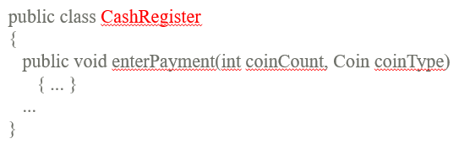
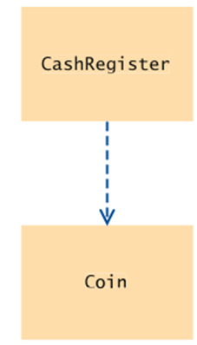

Dependency – UML Diagrams
UML Diagrams show the relationship between classes. The relationship is dependency when one class “depends” on another.
Uses-a relationship , uses an object or method/methods of another class
Example: CashRegister depends on Coin to determine the value of the payment

Slide 84
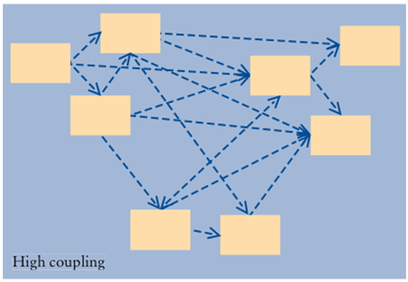
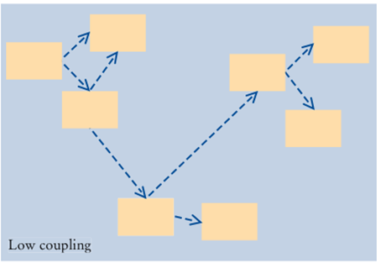
High and Low Coupling Between Classes
Low coupling is a better design. Proper cohesion is required for low coupling

Slide 85
The toString Method
All classes that represent objects should define a toString method
The toString method returns a character string that represents the object in some way
It is called automatically when an object is concatenated to a string or when it is passed to the print or println method
The programmer decides what a string representation of the object should look like

Slide 86
The toString Method
The default for a string representation of an object is the class name and the hash code (based on the memory location) of the object:
BankAccount momsSavings = new BankAccount(5000);
System.out.println(momsSavings);
// Would print out something like "BankAccount@d24606bf"

Slide 87
The toString Method
To provide a nicer representation of an object, give a definition to toString:
public String toString()
{
return "balance= " + balance;
}
This works better:
BankAccount momsSavings = new BankAccount(5000);
System.out.println(momsSavings);
// Would print out: balance= 5000
This header is required

Slide 88
public class MyName
{
private String firstName;
private String lastName;
private String middleName;
public MyName(String first, String middle, String last)
{
. . .
}
public String toString()
{
. . .
}
}
String result = “”;
result += firstName + “ “;
result += middleName + “ “;
result += lastName + “\n”;
return result;
Or:
return lastName + “, “ + firstName;
Write an implementation of the toString method

Slide 89
//***************************************************** // Die.java //****************************************************** public class Die { private final int MAX = 6; // maximum face value private int faceValue; // current value showing on the die //------------------------------------------------------ // Constructor: Sets the initial face value. //------------------------------------------------------ public Die() { faceValue = 1; } //------------------------------------------------------ // Rolls the die and returns the result. //------------------------------------------------------ public int roll() { faceValue = (int)(Math.random() * MAX) + 1; return faceValue; } //------------------------------------------------------ // Face value mutator. //------------------------------------------------------ public void setFaceValue (int value) { faceValue = value; }
//------------------------------------------- // Face value accessor. //--------------------------------------- public int getFaceValue() { return faceValue; }
//------------------------------------------------------- // Returns a string representation of this die. //----------------------------------------------------- public String toString() { String result = Integer.toString(faceValue); return result; } }

Slide 90
//******************************************************************** // RollingDice.java //******************************************************************** public class RollingDice { //----------------------------------------------------------------- // Creates two Die objects and rolls them several times. //----------------------------------------------------------------- public static void main (String[] args) { Die die1, die2; int sum; die1 = new Die(); die2 = new Die(); die1.roll(); die2.roll(); System.out.println ("Die One: " + die1 + ", Die Two: " + die2); die1.roll(); die2.setFaceValue(4); System.out.println ("Die One: " + die1 + ", Die Two: " + die2); sum = die1.getFaceValue() + die2.getFaceValue(); System.out.println ("Sum: " + sum); sum = die1.roll() + die2.roll(); System.out.println ("Die One: " + die1 + ", Die Two: " + die2); System.out.println ("New sum: " + sum); } }
What is the output if the
Following values were
Returned from roll:
3
5
2
3
6
Die One: 3, Die Two: 5
Die One: 2, Die Two: 4
Sum: 6
Die One: 3, Die Two: 6
New sum: 9

Slide 91
The toString Method
The toString method of a class can be called explicitly:
Stock xyzCompany = new Stock ("XYZ", 9.62);
System.out.println(xyzCompany.toString());
However, the toString method does not have to be called explicitly but is called implicitly whenever you pass an object of the class to println or print.
Stock xyzCompany = new Stock ("XYZ", 9.62);
System.out.println(xyzCompany);

Slide 92
The toString method
The toString method is also called implicitly whenever you concatenate an object of the class with a string.
Stock xyzCompany = new Stock ("XYZ", 9.62);
System.out.println("The stock data is:\n" + xyzCompany);

Slide 93
The toString Method
All objects have a toString method that returns the class name and a hash of the memory address of the object.
We can override the default method with our own to print out more useful information.
Examples: Stock.java, StockDemo1.java

Slide 94
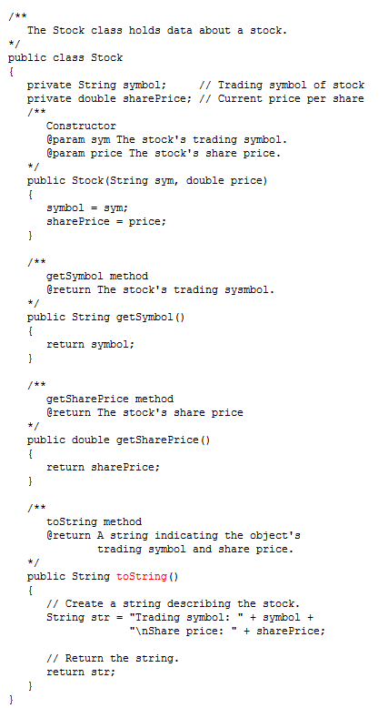
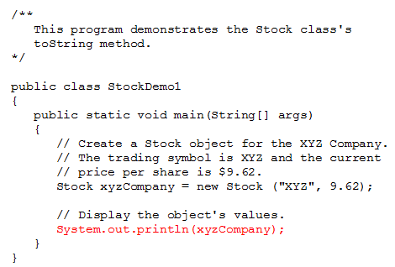
toString for Stock object called implicitly

